Slide 1
Hacking on Azure
With Node.js on Azure Websites
@DanielLarsenNZ

Slide 2
This talk
“Hacking”
Spotify Web API
Azure Websites + Node.js
Azure WebJobs + C#

Slide 3
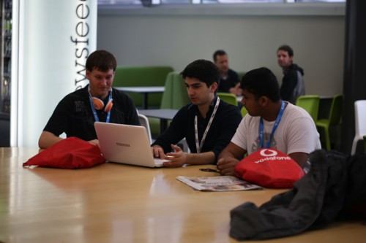

http://hackakl.org.nz/
Notes:
Hacking is: “The act of engaging in programming in a spirit of playfulness and exploration.
Hacker is: “A person who enjoys exploring the details of programmable systems and stretching their capabilities.
“Hacking entails some form of excellence, for example exploring the limits of what is possible, thereby doing something exciting and meaningful.

Slide 4
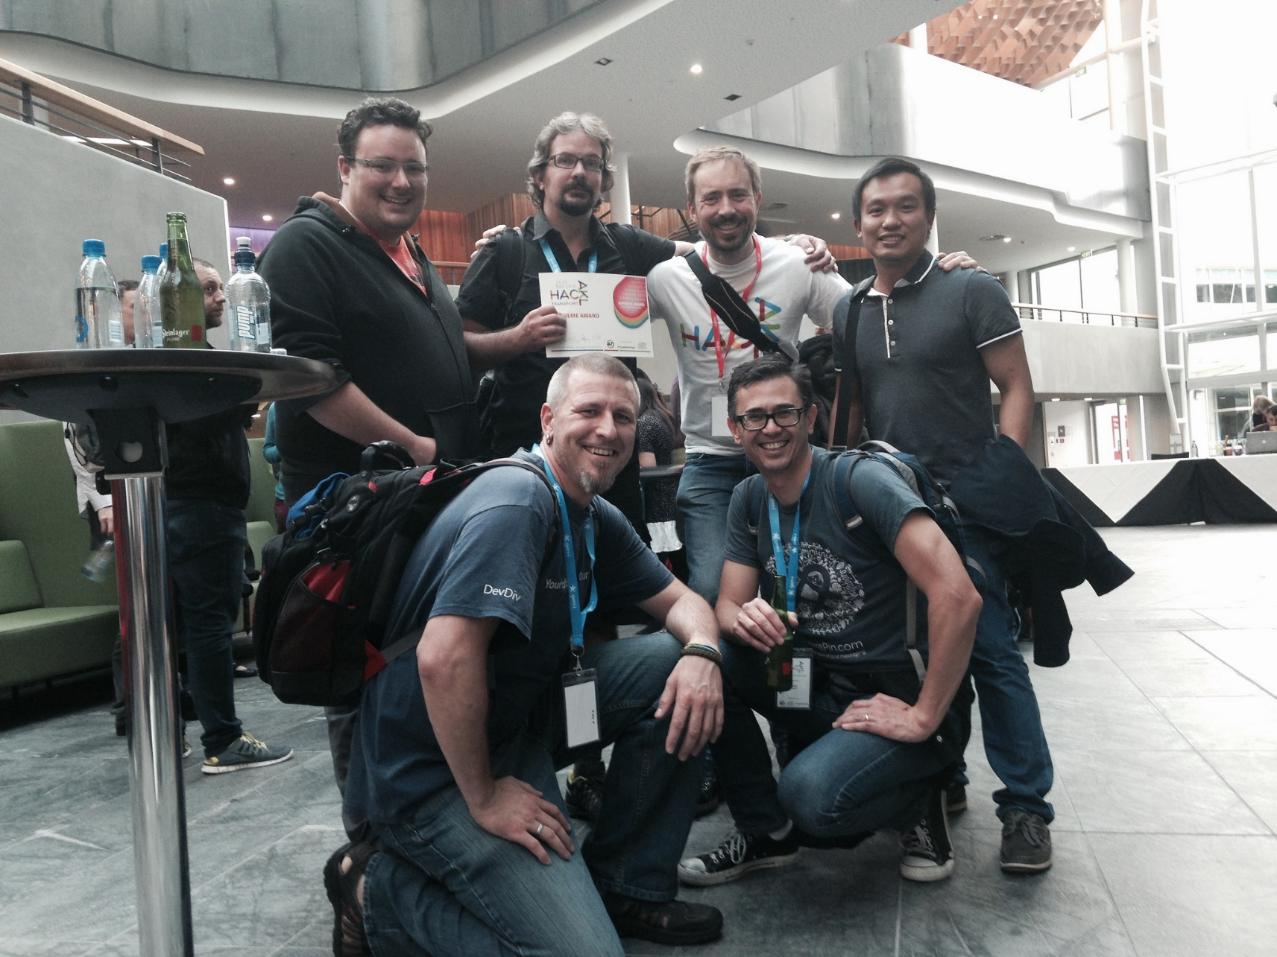

Slide 5
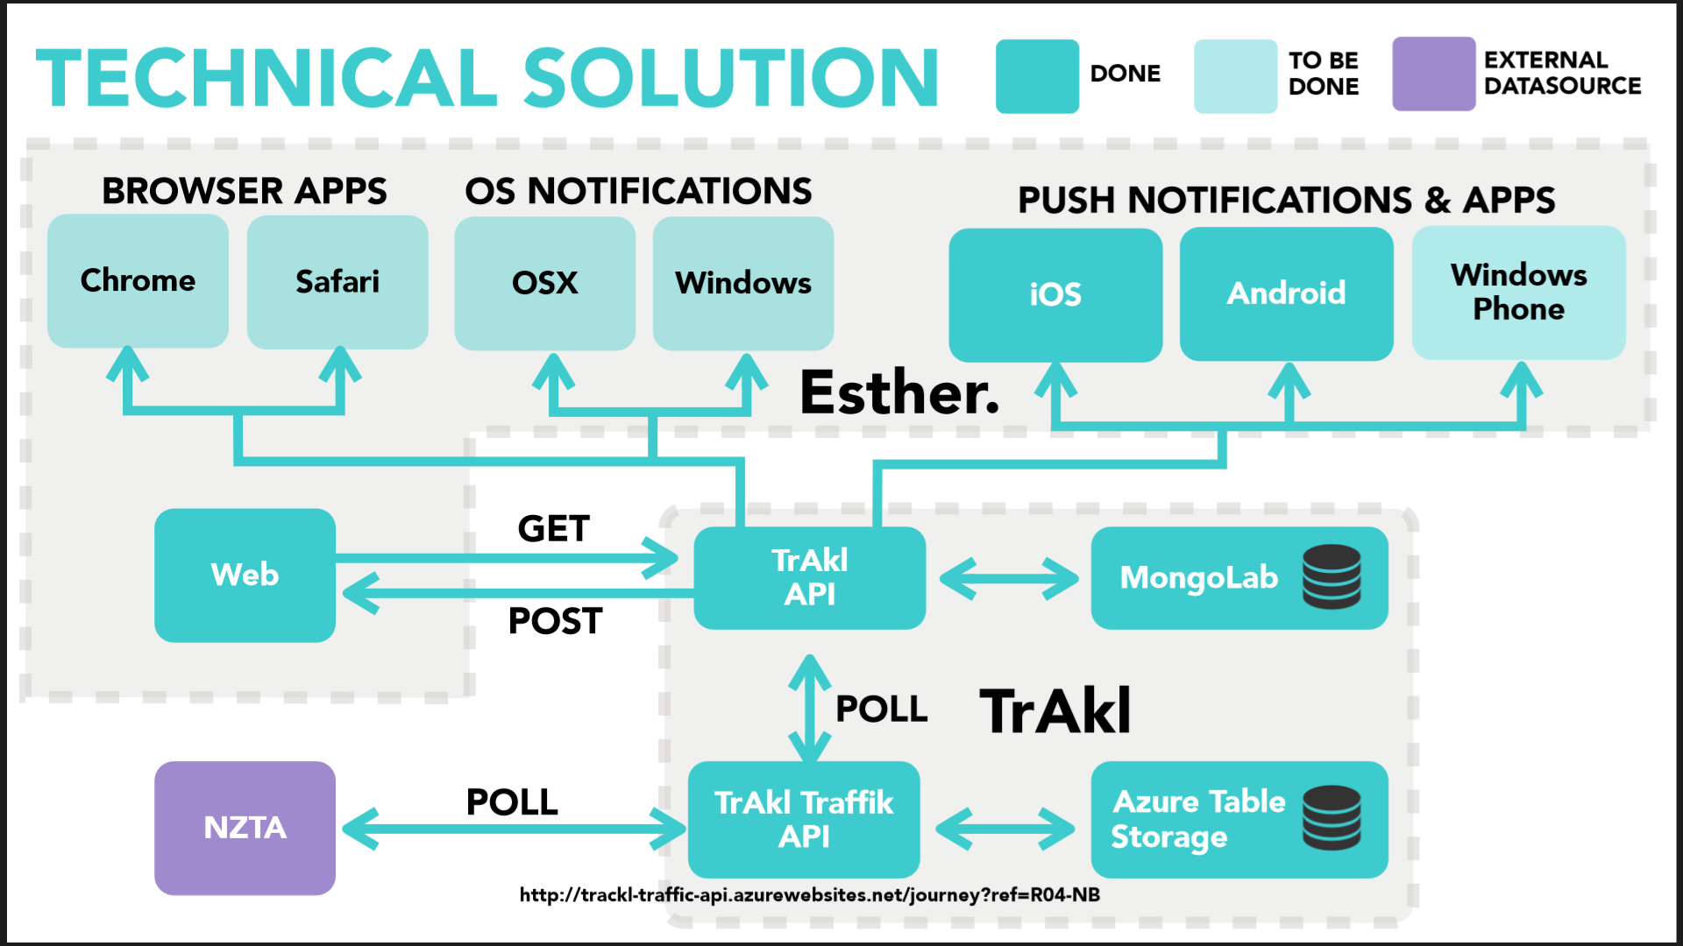

Slide 6
Demo
Node.js + NTVS + Azure Websites

Slide 7
Spotify Web API
https://developer.spotify.com

Slide 8
Demos
https://developer.spotify.com/web-api/
http://music.xbox.com/Developer
http://lab.possan.se/thirtify

Slide 9
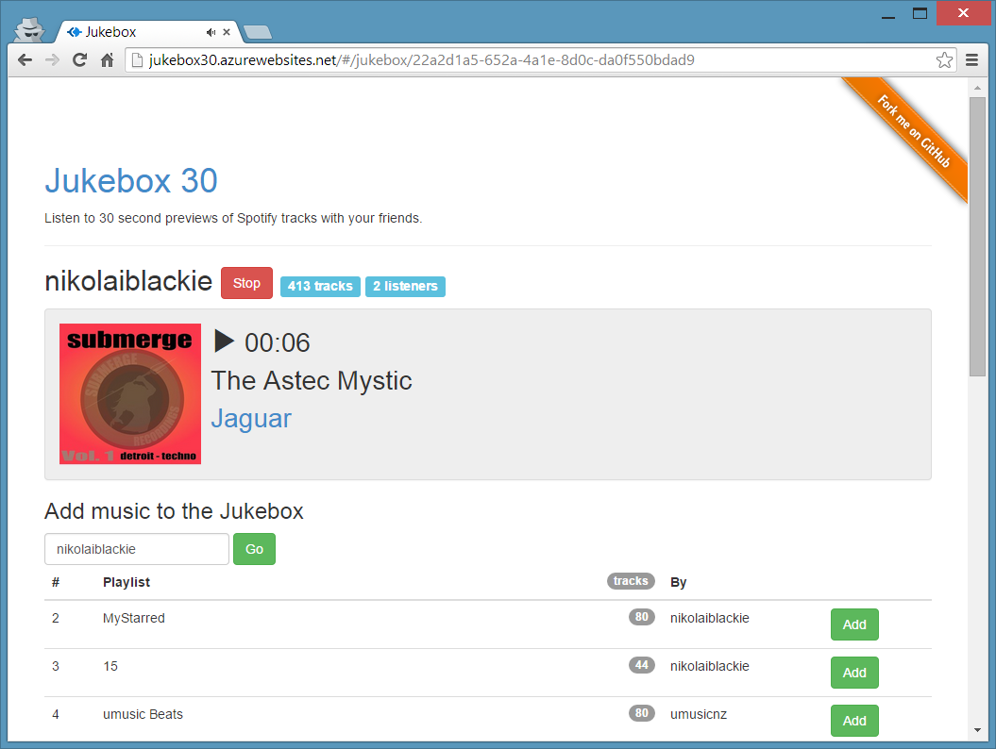
http://jukebox30.azurewebsites.net

Slide 10
Feature map
Feature | Stories
Jukeboxes | Create | List | Get/View
Playlists | Get | Import Tracks
Player | Start | Stop | View meta-data

Slide 11
Architecture
Browser
Azure Storage
Bootstrap
Queue Storage
Azure Website
Angular.js
express
socket.io
socket.io
Table Storage
Node.js
iisnode
WebJobs
Spotify Web API

Slide 12
Azure WebJobs + C#

Slide 13
Codez

Slide 14
Recap
“Hacking”
Spotify Web API
Azure Websites + Node.js
Azure WebJobs + C#

Slide 15
What I didn’t talk about
New Relic
Newman
GitHub deploy
Kudu
Edge.js
CoreCLR, OWIN, Density
Azure costs
Visual Studio Monaco
Lean

Slide 16
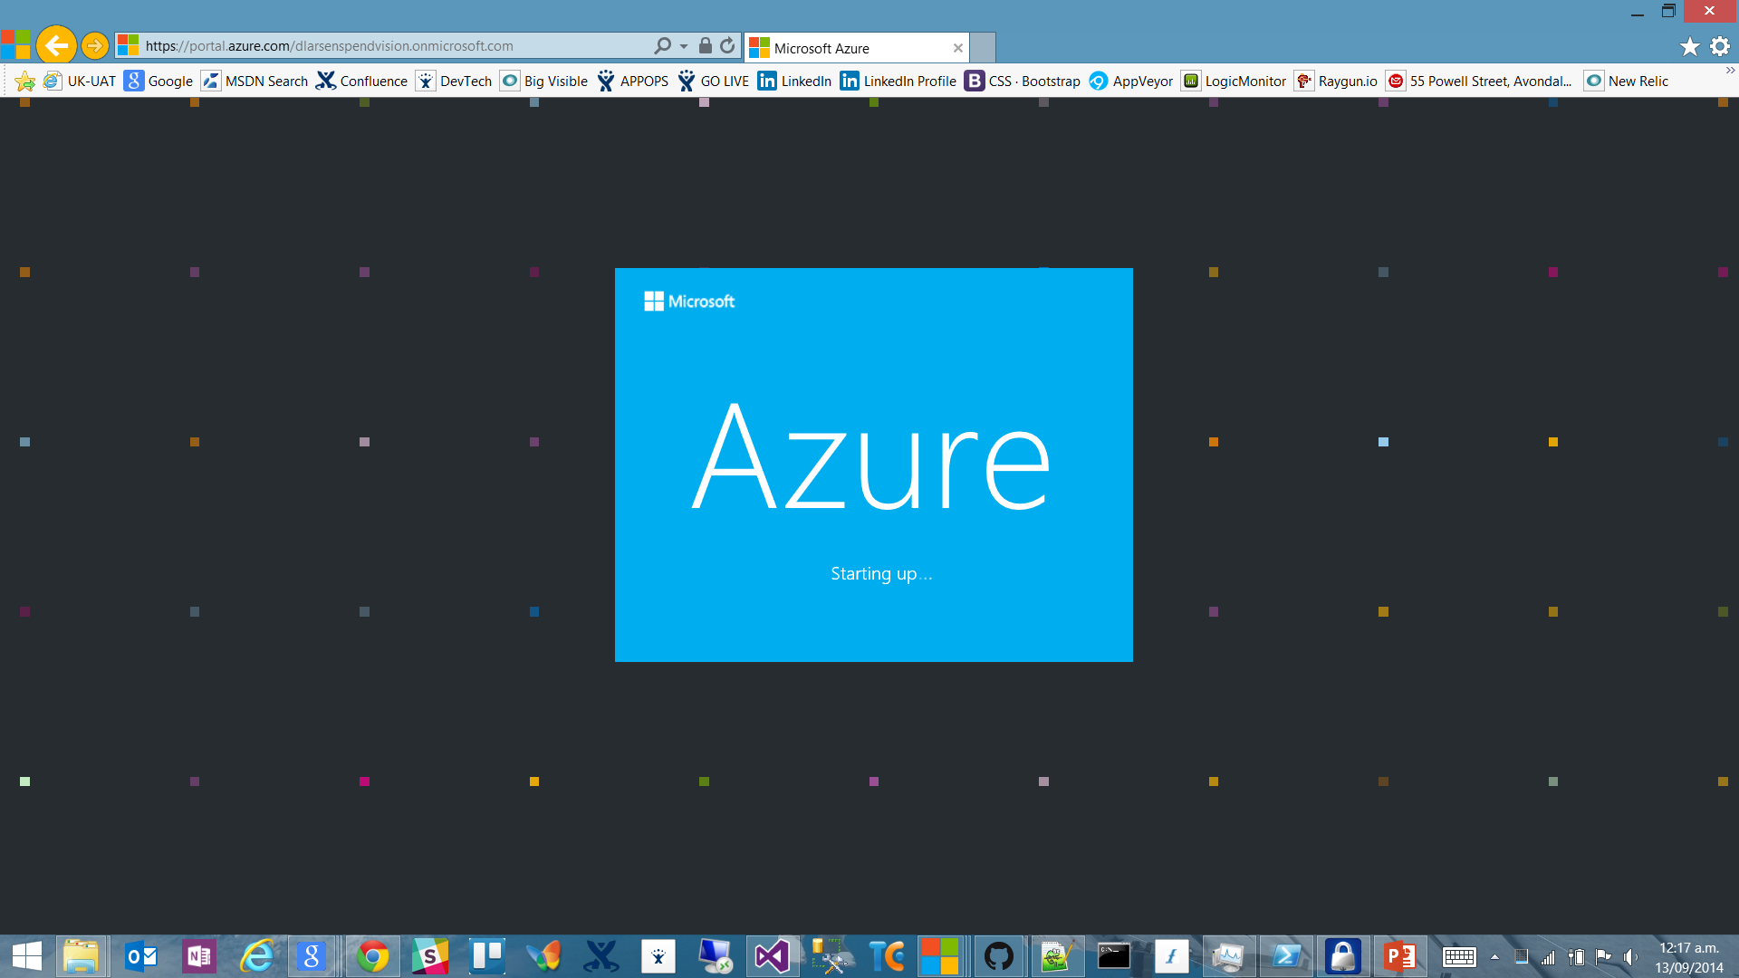

Slide 17
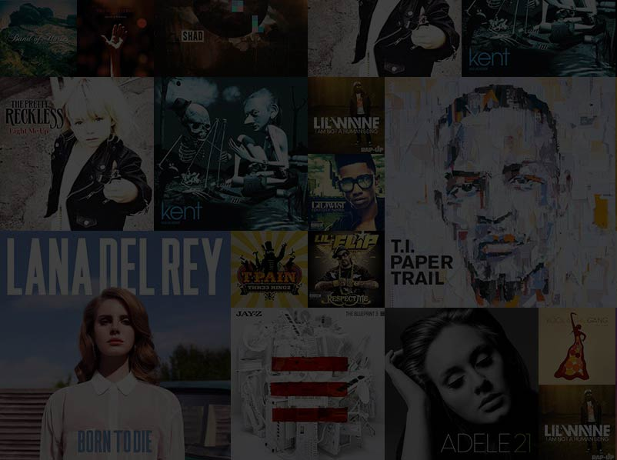

Slide 18

http://en.memory-alpha.org/wiki/Phoenix

Slide 19

By NASA [Public domain], via Wikimedia Commons http://commons.wikimedia.org/wiki/File%3AApollo_11_Earth.jpg

Slide 20
Chur!
Daniel Larsen
@DanielLarsenNZ
https://github.com/DanielLarsenNZ/Hacking-on-Azure

Slide 21
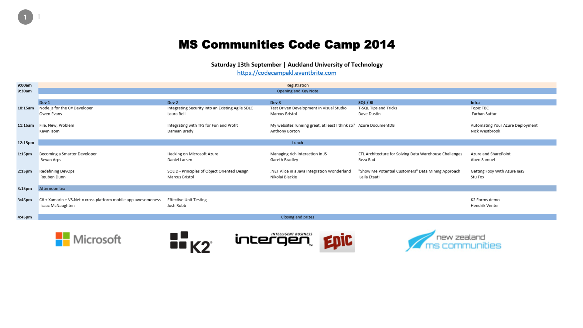

Slide 22
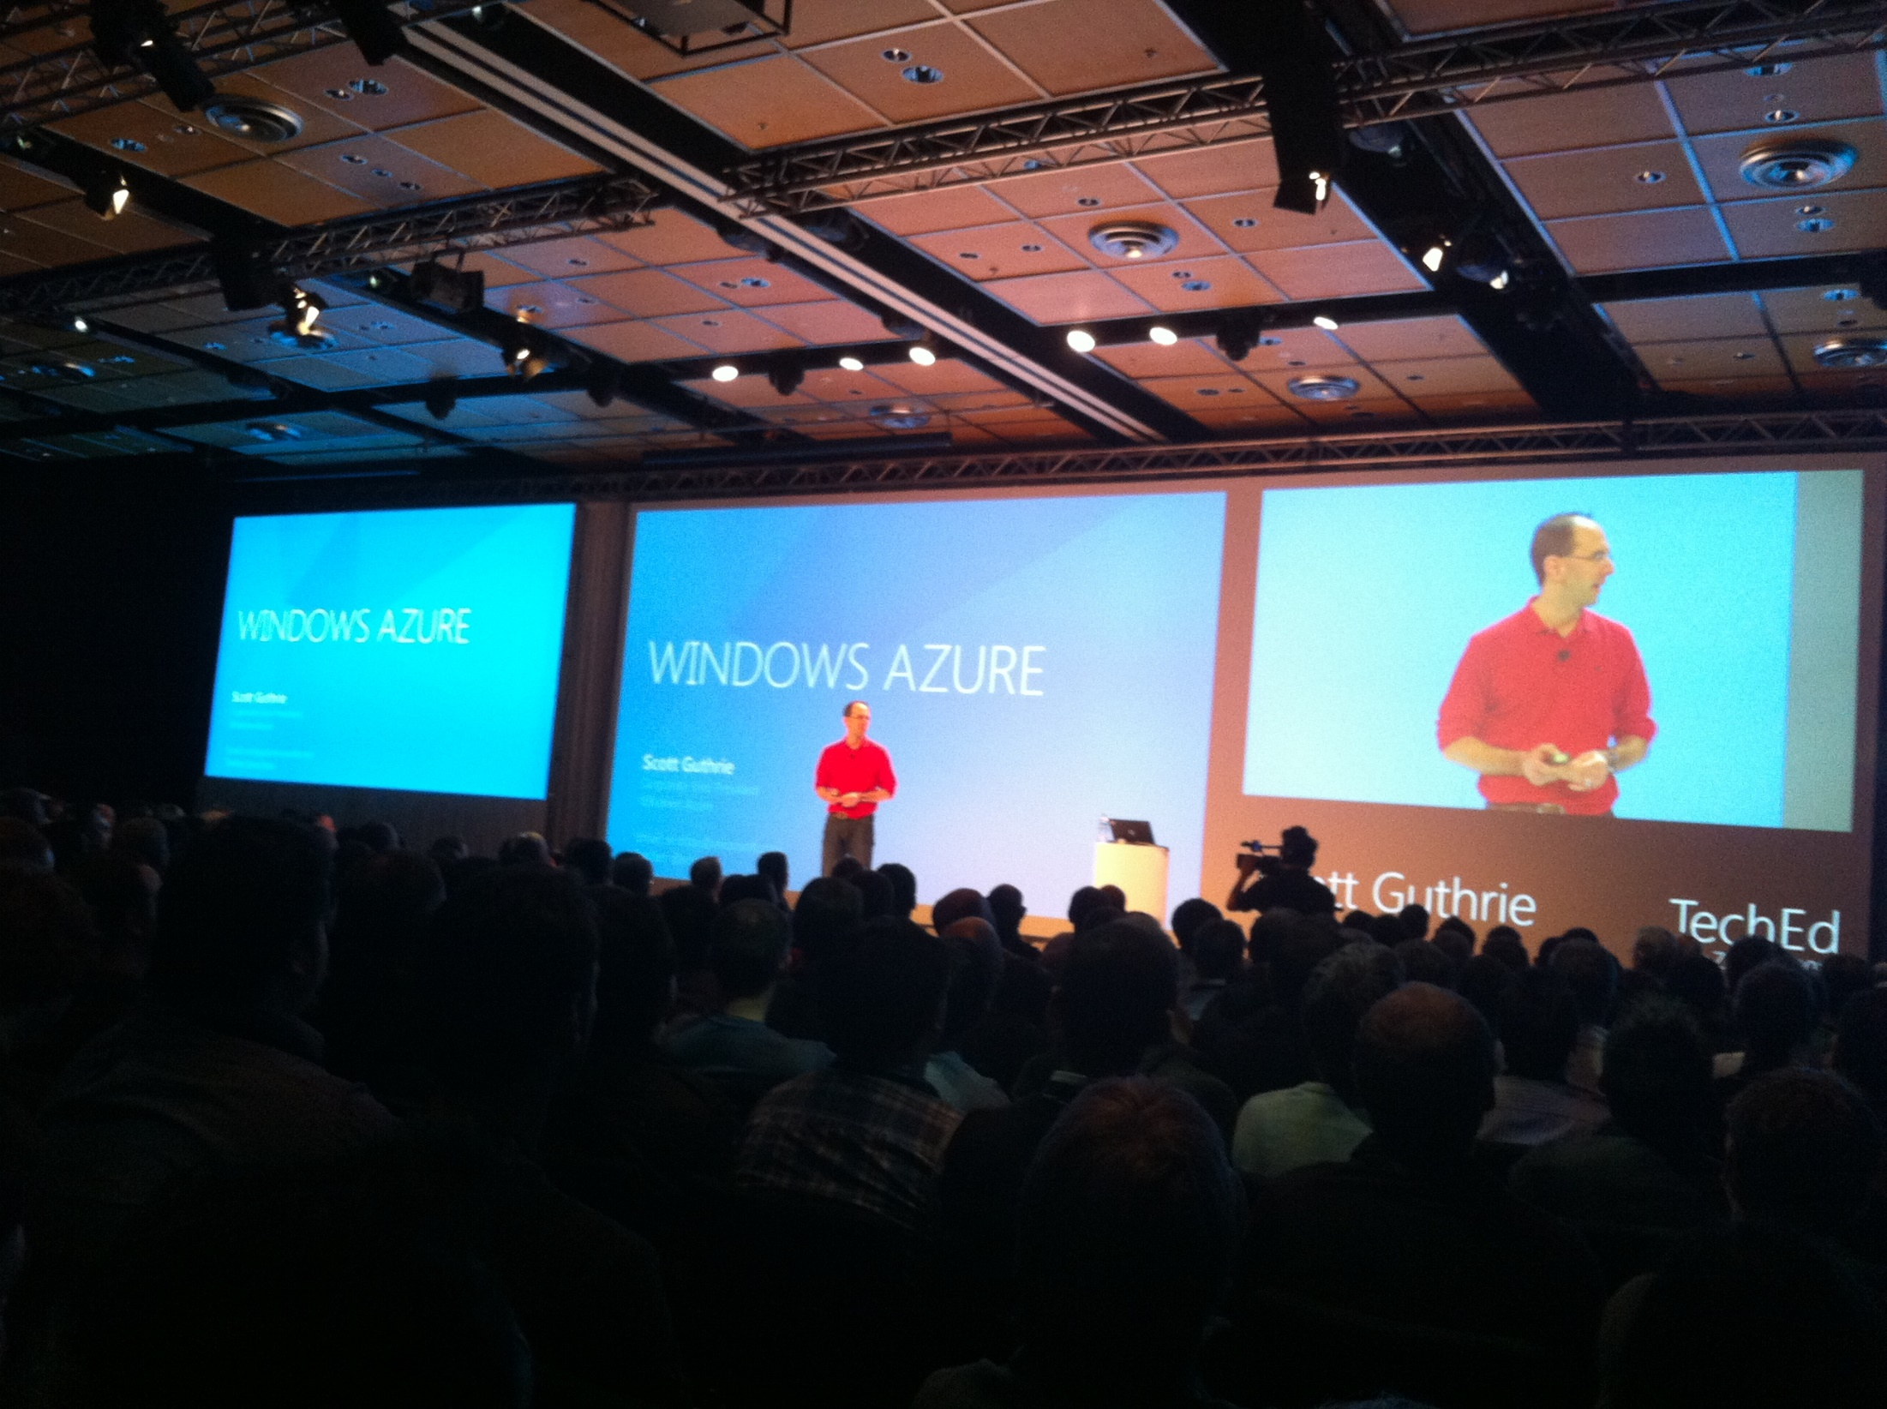

Slide 24
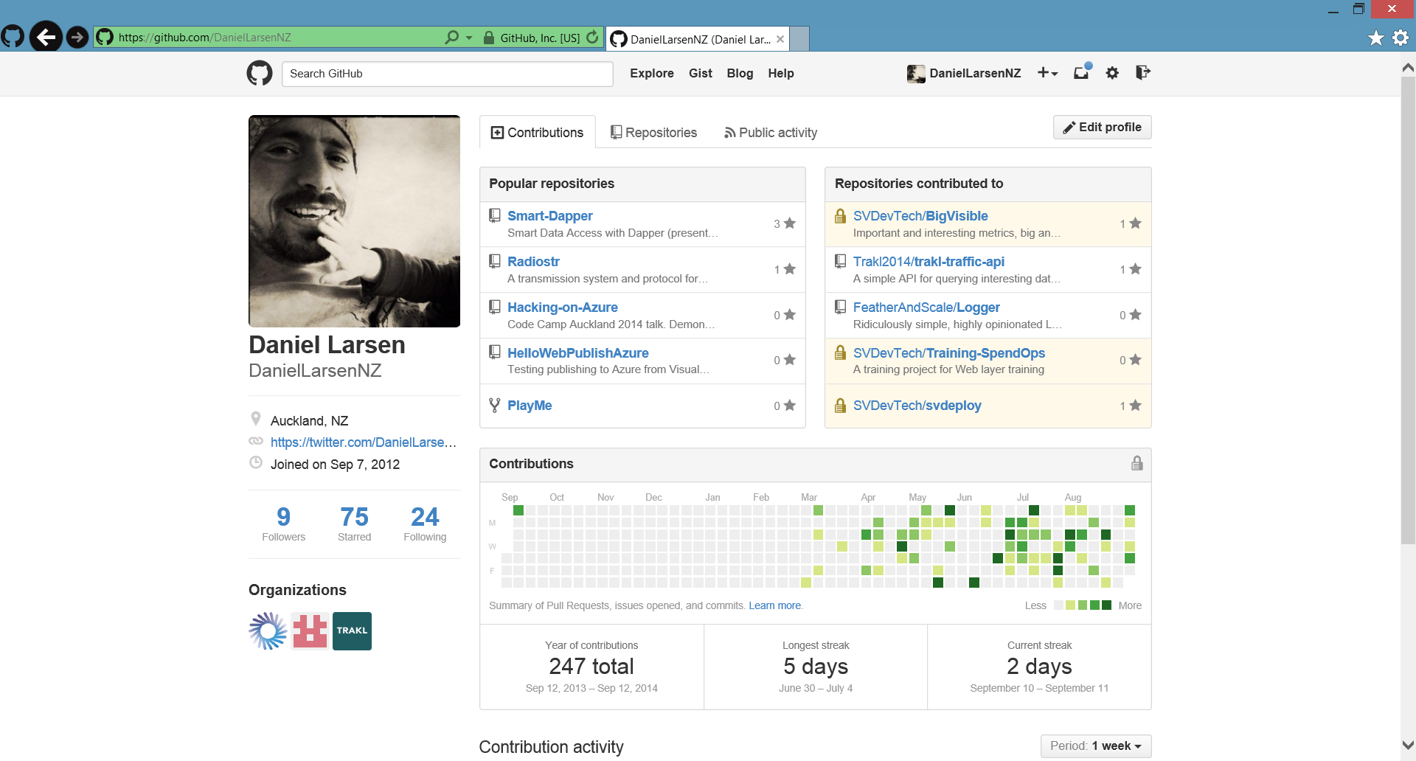

Slide 25
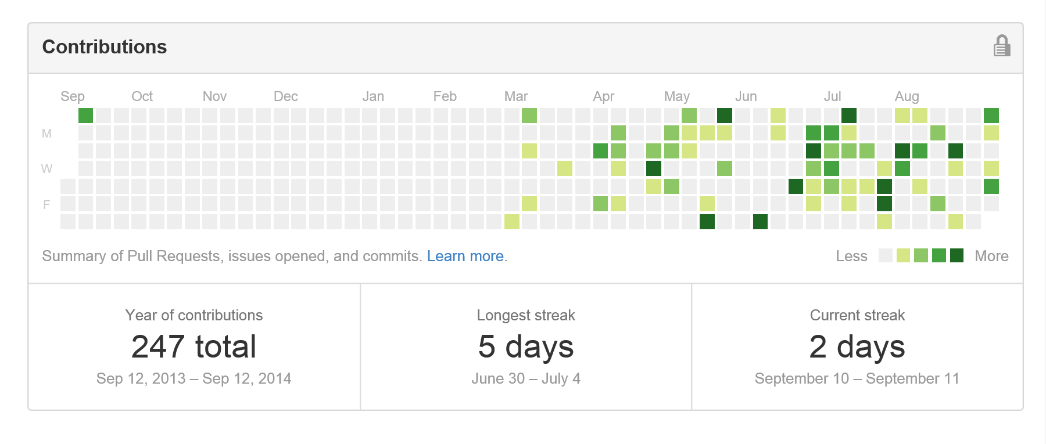
Contribution addiction

Slide 26
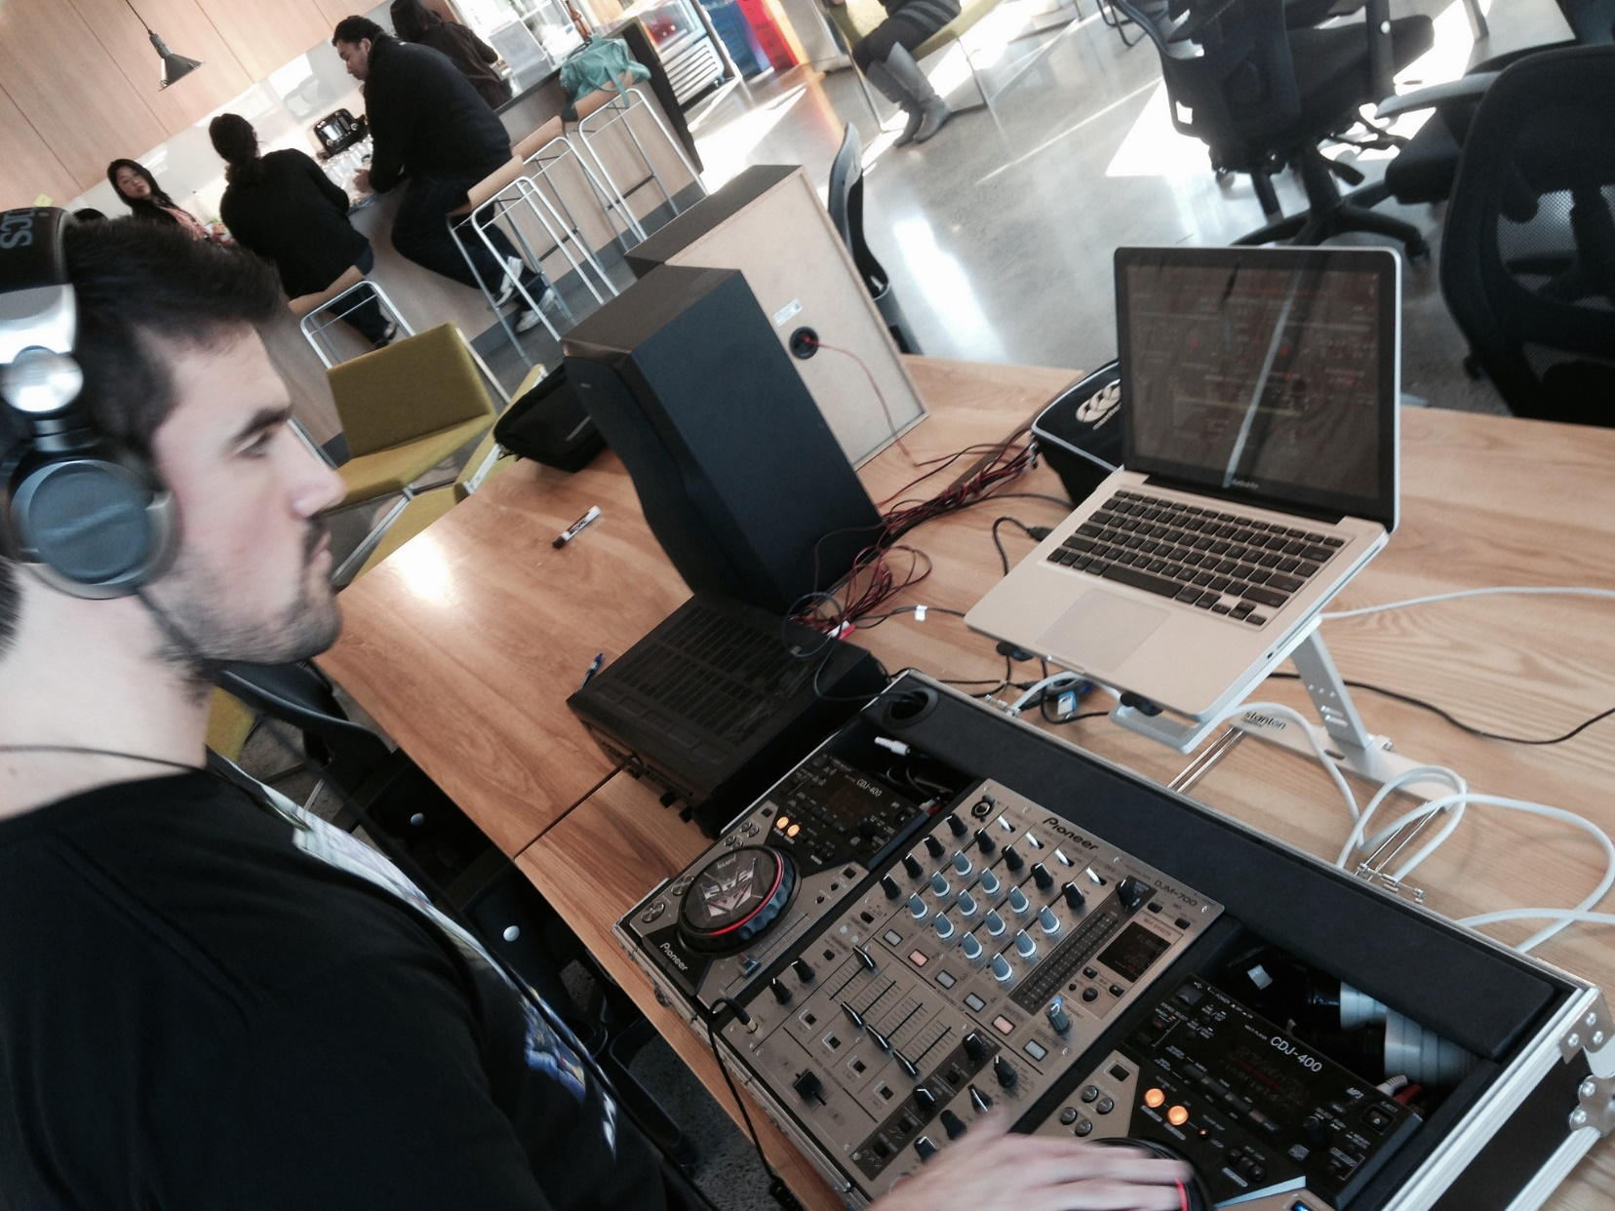

Slide 27
http://en.memory-alpha.org/wiki/Phoenix

Slide 28
By NASA [Public domain], via Wikimedia Commons http://commons.wikimedia.org/wiki/File%3AApollo_11_Earth.jpg

Slide 29
Hacking
(This is not a Security talk)

Slide 30
Hacking is exploration
“The act of engaging in programming in a spirit of playfulness and exploration.
http://en.wikipedia.org/wiki/Hacker_(programmer_subculture)

Slide 31
Hacker enjoys exploring
“A person who enjoys exploring the details of programmable systems and stretching their capabilities.
http://en.wikipedia.org/wiki/Hacker_(programmer_subculture)

Slide 32
What is possible?
“Hacking entails some form of excellence, for example exploring the limits of what is possible, thereby doing something exciting and meaningful.
http://en.wikipedia.org/wiki/Hacker_(programmer_subculture)

Slide 33
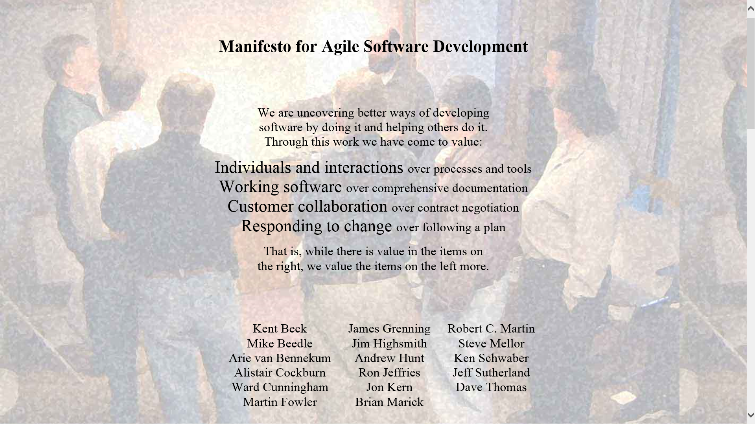

Slide 34
Architecture phase 1
Browser client (Angular.js)
Azure Website
(Node.js)
Spotify Web API
Queue Storage

